Slide 1

Insights gained from web Scraping

Slide 2
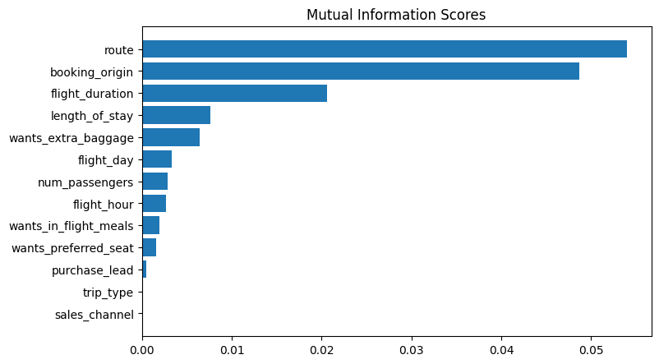
Insights about features affective customer behaviour and accuracy of predictive model
Top Features Influencing Customer’s Behaviour:
Route
Booking origin
Duration of flight
Length of stay
Extra baggage
Random Forest Classifier was used to train the dataset
ACCURACY: 84.6
AUC score: 0.5527204586681345

